Slide 1
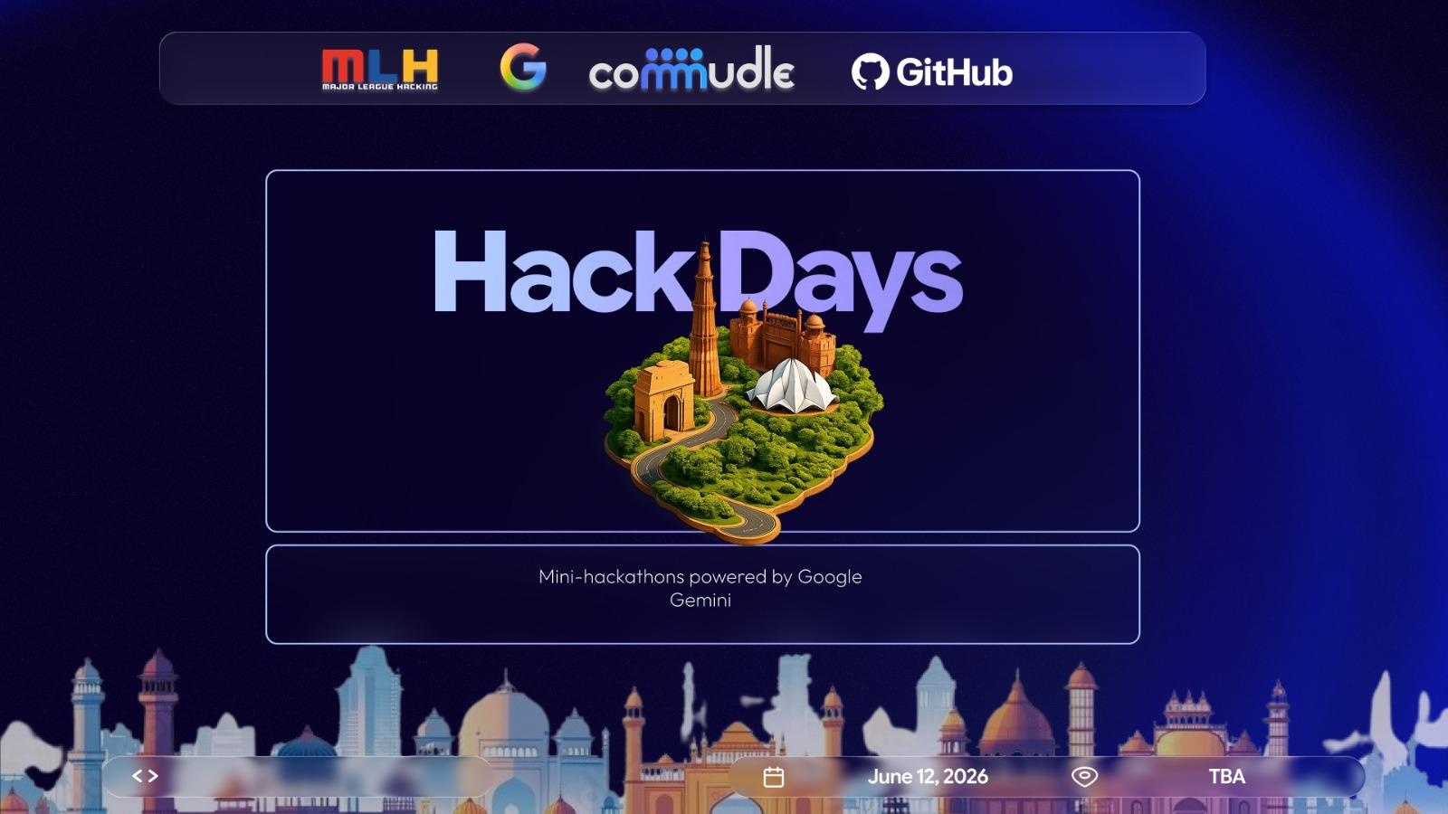



Slide 2

2
Problem Statement
Build an Intelligent Data Dictionary Agent that leverages AI to automatically interpret complex datasets and generate contextual metadata, including column definitions, data lineage, relationships, and usage insights. The system should enable natural language interaction, allowing users to query and understand datasets easily, while ensuring consistency, governance, and real-time updates across evolving data sources.

Slide 3
3
Solution
DataMorphix : AI-Powered Intelligent Data
Dictionary Agent
DataMorphix is an AI-powered Intelligent Data Dictionary platform designed to automatically analyze, understand, and document complex datasets. The system helps users explore datasets without manually reading schemas or technical documentation.
Users can upload datasets such as CSV, Excel, or JSON files, and the AI engine automatically:
interprets columns,
generates metadata,
detects relationships,
tracks data lineage,
provides usage insights,
and answers dataset-related questions using natural language interaction.
The platform combines AI analysis, metadata intelligence, and graph-based relationship visualization to simplify data understanding and governance.

Slide 4
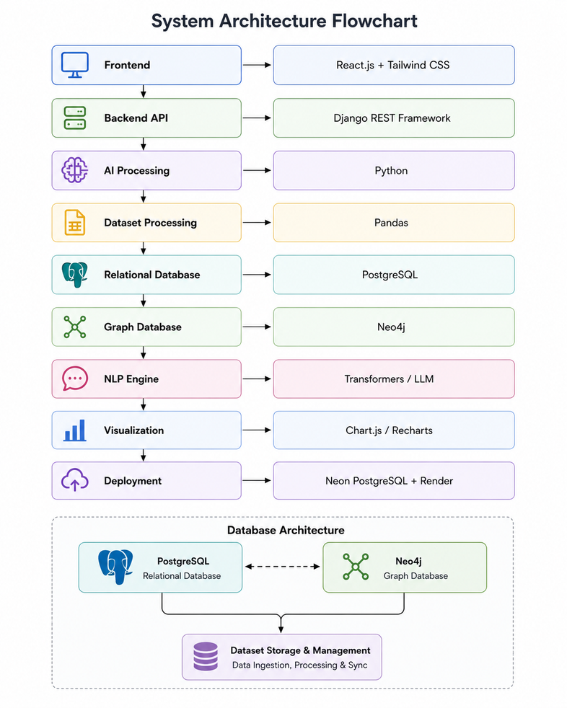
4
Tech Stack & Architecture
Component Technology
Frontend React.js + Tailwind CSS
Backend API Django REST Framework
AI Processing Python
Dataset Processing Pandas
Relational Database PostgreSQL
Graph Database Neo4j
NLP Engine Transformers / LLM
Visualization Chart.js / Recharts
Deployment Neon PostgreSQL + Render
Database Architecture PostgreSQL

Slide 5
5
Data Flow Diagram
Pandas reads file
User Uploads Dataset
Gemini AI Generate analysis
Relationship & Lineage Detection
Health score
Generation
Save Metadata to database
Dashboard & Export System
Governance Analysis &
Save changes to Database

Slide 6
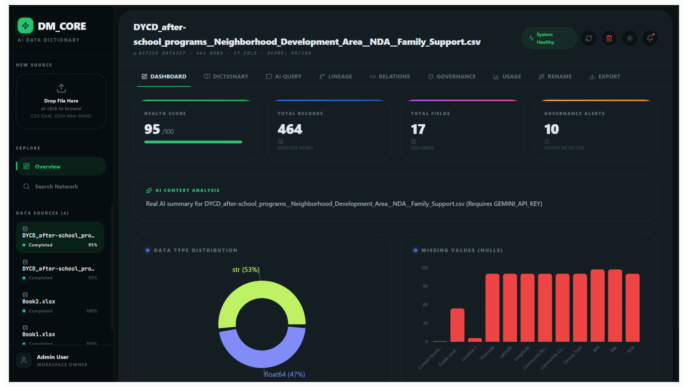
6
Screenshot & Repository Link
https://github.com/YugPatel11/DataMorphix

